Slide 1
Genetic Algorithms for Best Possible Flight (INFO6205_08)
Team 08
Hardik Jain
Shikha Shah

Slide 2
Table Of Contents
Problem Statement
Overview
Approach
Output
Test Cases

Slide 3
Problem Statement
The Genetic Algorithm focusses on finding the best possible flight from one city to another.
The fitness of a particular flight is defined by the time it takes and the price of a ticket on the flight.
The best flights from a particular population are chosen for crossover leading to better flights.
Each iteration leads to the creation of a new generation which leads to creation of new better off springs.
The logger displays the fitness of the new species, the fitness of the one culled in that iteration and the fitness of the new species before and after mutation if mutation takes place.

Slide 4
Genetic Algorithms

Slide 5
Overview
We are taking flights whose chromosomes and traits are based on time taken and prize.
Fitness function is evaluated based on time and cost of flight.
Selection is made on the basis of top two fittest flight in terms of time and prize.
Then crossover and mutation is done, resulting in new breed of flights.

Slide 6
Genetic Code
public void genearateTimeArray() {
int size = timeArray.length;
for (int i = 0; i < size; i++) {
double random = Math.random();
timeArray[i] = (int)Math.round(random);
}
}
public void genearatePriceArray() {
int size = priceArray.length;
for (int i = 0; i < size; i++) {
double random = Math.random();
priceArray[i] = (int)Math.round(random);
}
}
// Used Random generator

Slide 7
The price step value gets added to the base price value for every element 0 in the price array. Changes to the above values can be made in the constants file
public int getPrice() {
int price = Constants.BASE_PRICE;
for (int i = 0; i < priceArray.length; i++)
price = priceArray[i] == 0 ? price + Constants.PRICE_STEP : price;
return price;
}
The same goes for base time value.

Slide 8
Fitness Function
public Integer calculateFitness() {
int fitness = 0;
for (int i = 0; i < timeArray.length; i++) {
if (timeArray[i] == 1)
++fitness;
if (priceArray[i] == 1)
++fitness;
}
this.fitness = fitness;
return fitness;
}

Slide 9
Comparison of different flights based on fitness function
public int compareTo(Flight o) {
Integer fit1 = calculateFitness();
Integer fit2 = o.calculateFitness();
if (fit1 - fit2 > 0)
return -1;
else if (fit1 - fit2 < 0)
return 1;
else
return 0;
}

Slide 10
Selection
private void doSelectionAndCrossover() {
int cullCount = (int)(Constants.CULL_RATIO * flights.size());
for(int i = 1; i <= cullCount; i++) {
//Choosing the 2 best species
Flight flight1 = getFittest();
Flight flight2 = flights.get(1);
Flight newFlight = doCrossover(flight1, flight2);
doMutation(newFlight);
doCull();
}
}

Slide 11
Crossover
private Flight doCrossover(Flight flight1, Flight flight2) {
Flight newFlight = generateFlight();
int cutoff = (int)Math.floor(Math.random() * 10);
int size = flight1.getTimeArray().length;
int[] priceArray = newFlight.getPriceArray();
int[] priceArray1 = flight1.getPriceArray();
int[] priceArray2 = flight2.getPriceArray();
int[] timeArray = newFlight.getTimeArray();
int[] timeArray1 = flight1.getTimeArray();
int[] timeArray2 = flight2.getTimeArray();
for(int i = 0; i < size; i++) {
if(i <= cutoff) {
priceArray[i] = priceArray1[i];
timeArray[i] = timeArray1[i];
}
else {
priceArray[i] = priceArray2[i];
timeArray[i] = timeArray2[i];
}
}
newFlight.calculateFitness();
logger.info("New fitness : " + newFlight.getFitness());
return newFlight;
}

Slide 12
Mutation and Cull
private void doMutation(Flight flight) {
if(Math.random() < 0.08) {
logger.info("Fitness before mutation : " + flight.getFitness());
int bit = (int) Math.floor(Math.random() * 10);
flight.getPriceArray()[bit] = flight.getPriceArray()[bit] == 0 ? 1 : 1;
flight.getTimeArray()[bit] = flight.getTimeArray()[bit] == 0 ? 1 : 1;
logger.info("Fitness after mutation : " + flight.calculateFitness());
logger.info("");
}
private void doCull() {
Collections.sort(flights);
Flight remove = flights.remove(flights.size() - 1);
logger.info("Culling fitness : " + remove.getFitness());
}

Slide 13
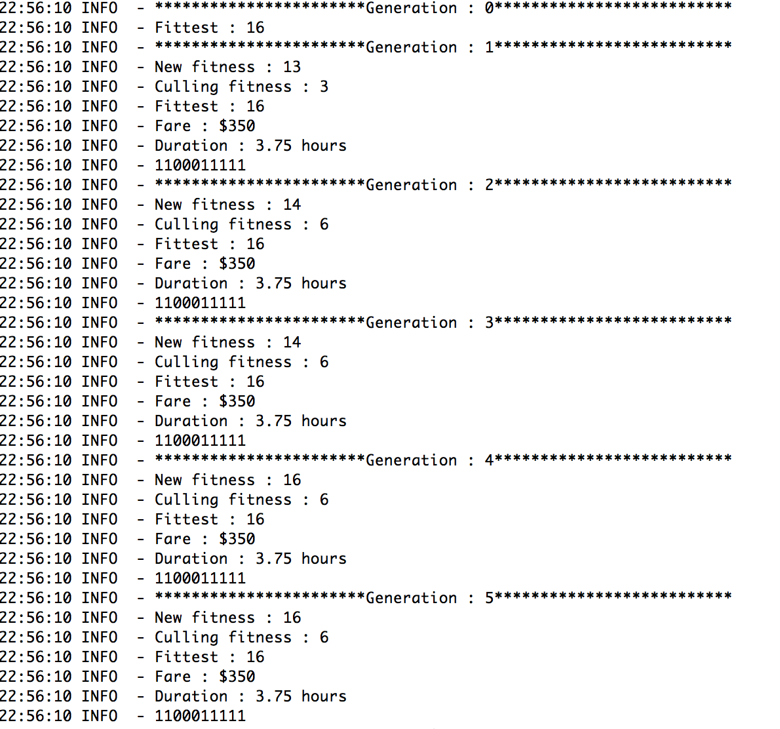
Outputs

Slide 14
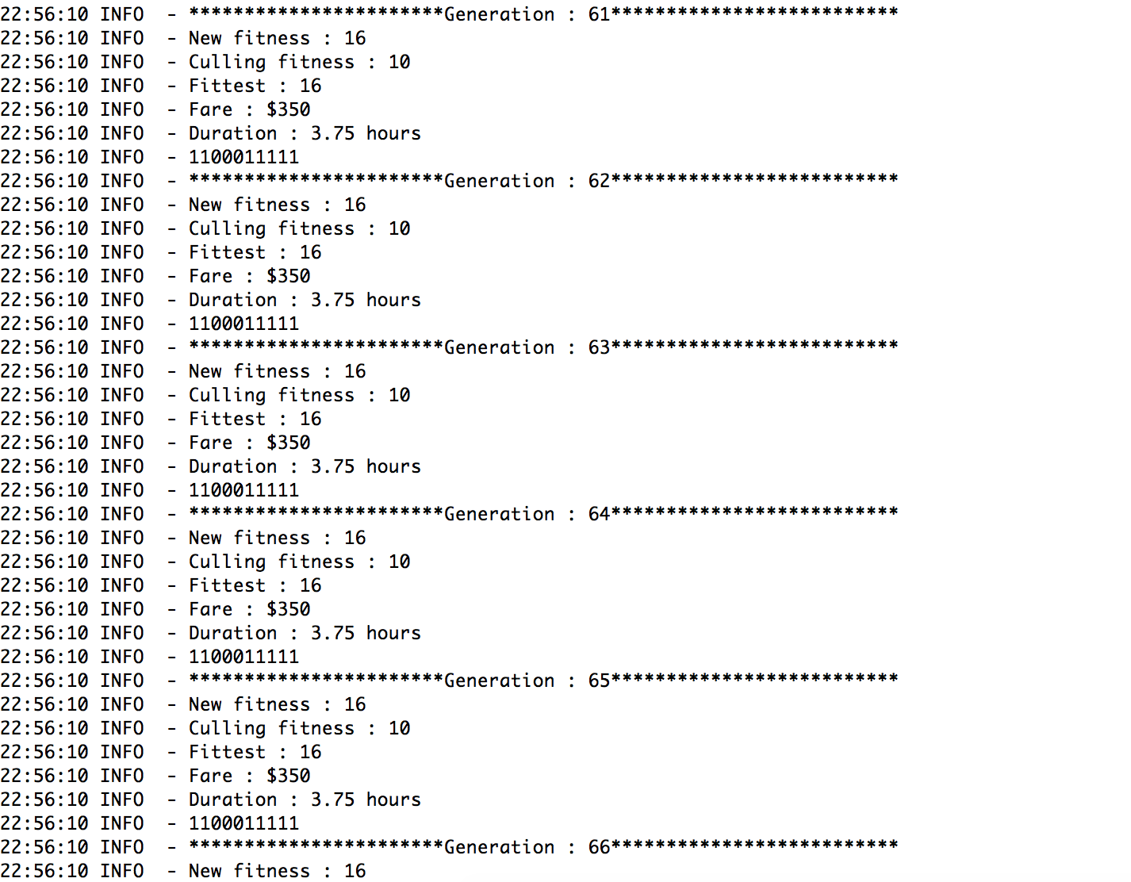
Outputs

Slide 15
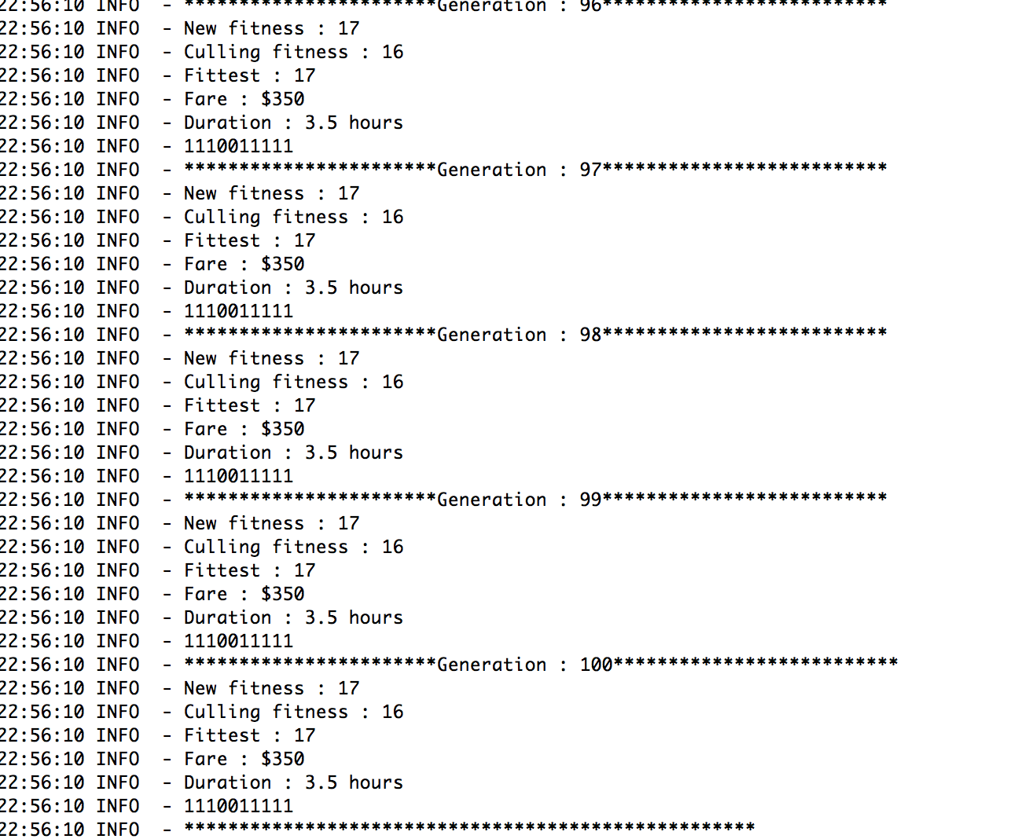
Outputs

Slide 16
Unit Tests
@Test
 | public void testFitness2() {
 | int[] priceArray = {1,1,0,0,0,1,1,0,0,1};
 | int[] timeArray = {1,0,1,0,0,0,0,0,0,1};
 | Flight flight = new Flight();
 | flight.setPriceArray(priceArray);
 | flight.setTimeArray(timeArray);
 | assertEquals(flight.getFitness(), 8);
 | }
 | @Test
 | public void testFlight() {
 | Population pop = new Population();
 | pop.generatePopulation();
 | assertEquals(pop.getFlights().size(), Constants.POPULATION_SIZE);
 | int tries = 1;
 | while (tries <= Constants.MIN_GENERATIONS || pop.getFittest().getFitness() < Constants.FITNESS_THRESHOLD) {
 | pop.evolve();
 | tries++;
 | }
 | assertTrue(pop.getFittest().getFitness() >= Constants.FITNESS_THRESHOLD);
 | }

Slide 17
Unit Test
@Test
 | public void testFitness() {
 | Flight flight = new Flight();
 | assertEquals(flight.getFitness(), 0);
 | }
 | @Test
 | public void testFitness1() {
 | int[] priceArray = new int[] {0,0,0,0,0,1,1,0,0,1};
 | int[] timeArray = new int[] {0,0,1,0,0,0,0,0,0,1};
 | Flight flight = new Flight();
 | flight.setPriceArray(priceArray);
 | flight.setTimeArray(timeArray);
 | assertEquals(flight.getFitness(), 5);
 | }

Slide 18
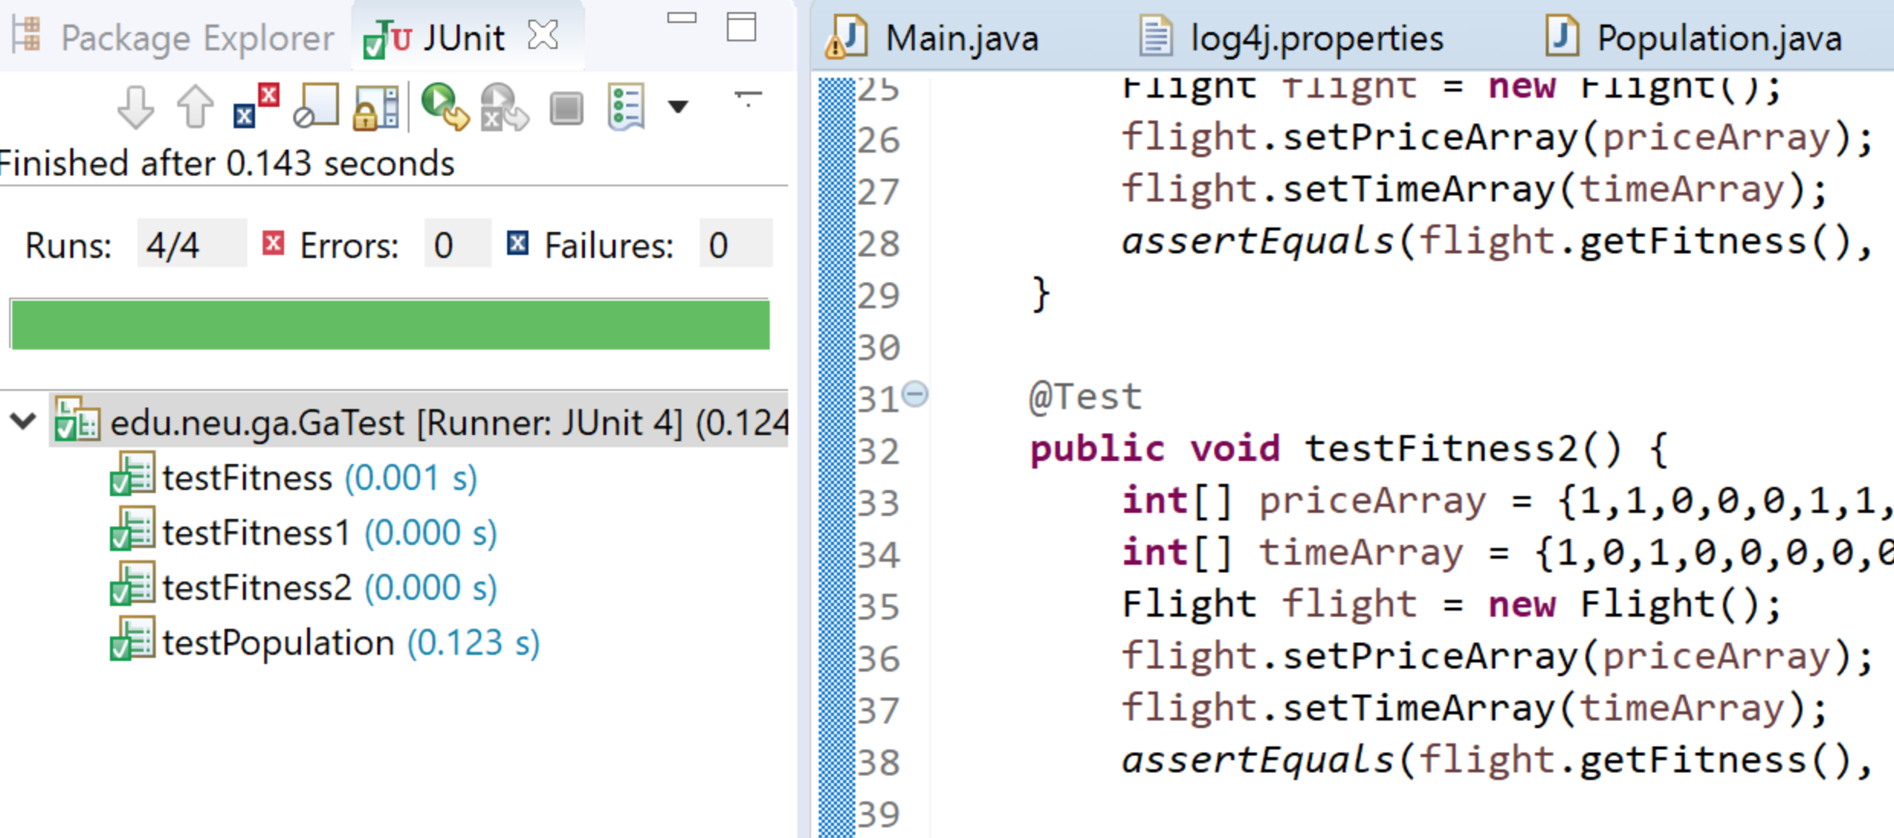
Unit Test Output

Slide 19
Thank you

